Slide 1
Agile Dev Practices and OO Techniques
A Course from
ThoughtWorks Studios
CONFIDENTIAL AND RESTRICTED.
These materials are for the sole use of the individuals to whom they were delivered, and any further copying or distribution is prohibited.
Notes:
Hello, and welcome to The Origins of Agile Software Development, a module in Agile Fundamentals. This module is brought to you by ThoughtWorks Studios, makers of Mingle, Go, and Twist.

Slide 2
Checklist
Verify that you have Internet connectivity
Download Intellij Idea V 11 Ultimate Edition

Slide 3
Housekeeping
Hours
Mobile phones
Break times
Restrooms
Emergencies

Slide 4
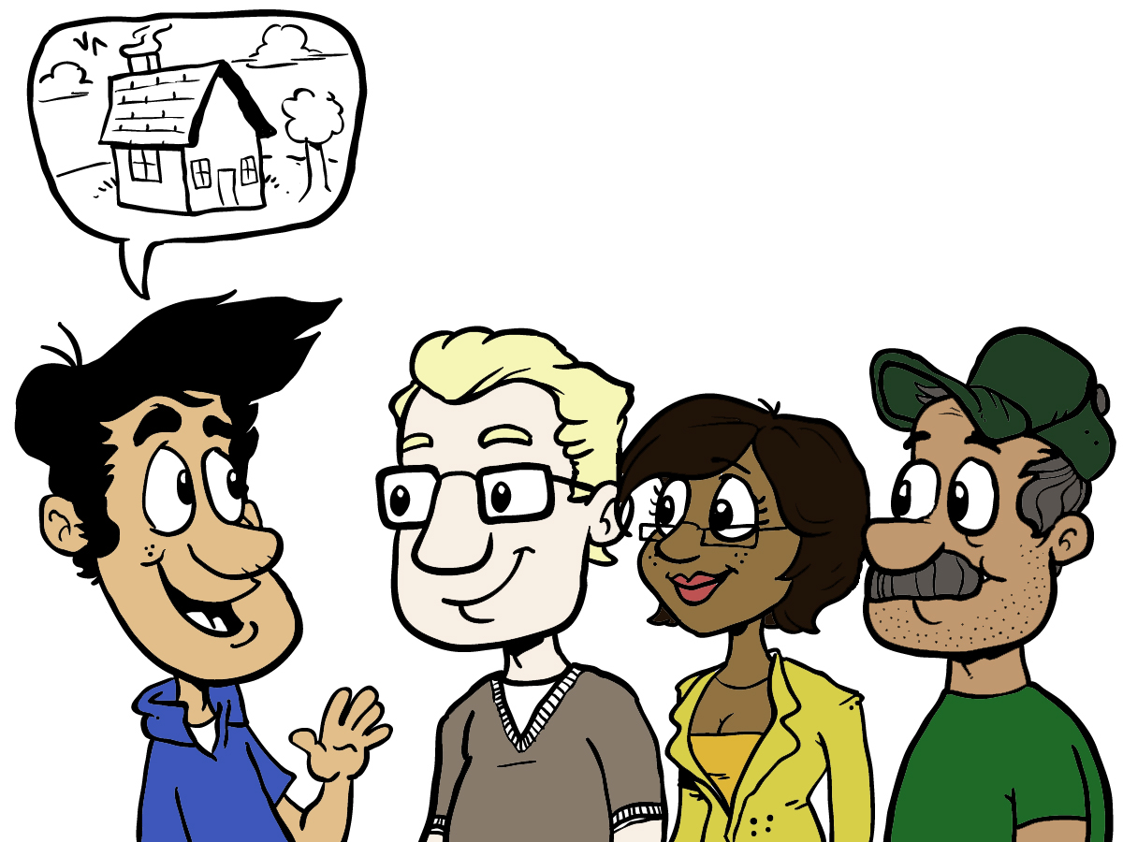
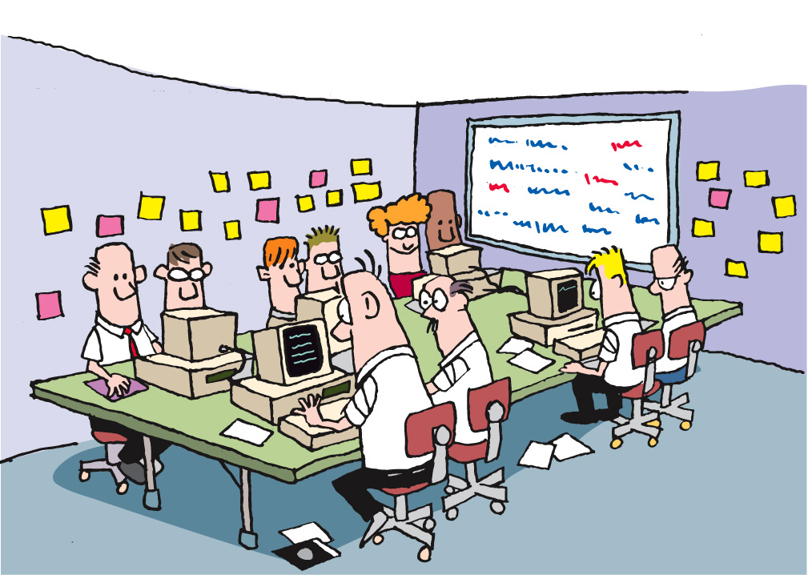
Housekeeping
for(int i=0; i<10; i++) {
System.out.println(“Hello World!”);
}
Notes:
Emphasize that there will be two main modes of learning used during the workshop: Presenting and Learning

Slide 5
Presenting
for(int i=0; i<10; i++) {
System.out.println(“Hello World!”);
}
One conversation
Laptops down
Notes:
Presenting is when someone (could be facilitator but often it’ll be one of the participants) is showing code or other artifacts on the display. During this mode, we’ll need everyone’s attention (laptops down or put aside). Questions and lively conversation is welcome; as long as rules of discourse are obeyed (one conversation at a time)

Slide 6
Coding
Several conversations
Use your inside voice!
Laptops open (of course)
Notes:
Coding is when the attendees will work on the code samples in pairs. This is “heads down” activity, with every pair focused on their workstation/laptop. There will be lots of “low-decibel” conversations (one per pair) in the room. The facilitators will help the attendees. The attendees will help each other as well. There will be a gentle “hum” of these several conversations in the room during the Coding mode.

Slide 7
Context Setting
We will review many concepts and write a lot of code to better understand principles and practices of object oriented code.
This is not a custom class for your organization.
We will try to address various advanced topics, but some are too complex to get into.
Your next steps are to identify how to apply the principles and practices you learn here to the code you write for your organization.

Slide 8
What’s coming up…
Agile best practices
Coding problems
Area and perimeter
Units of Measure
Enhancing an existing application
Notes:
TIMING: <= 2 minutes
Just a sentence or two about each topic

Slide 9
Agile Best Practices
Automated
Build/Deploy
Iteration kickoff/ planning meeting
Short
Releases
Pair
Programming
Retrospectives
Refactoring
Automated
Testing
Daily
Stand-ups
Collective
Ownership
Card Wall
Simple Design
Velocity
Metrics
Test Driven
Development
Coding
Standards
Iterations
Co-location
INDIVIDUAL
User
Stories
Sustainable
Pace
Continuous
Integration
TEAM
On-site
Customer
ORGANIZATIONAL

Slide 10
Our Subset
Automated
Build/Deploy
Short
Releases
Pair
Programming
IKO/IPM
Retrospectives
Refactoring
Automated
Testing
Daily
Stand-ups
Collective
Ownership
Card Wall
Simple Design
Velocity
Metrics
Test Driven
Development
Coding
Standards
Iterations
Co-location
INDIVIDUAL
User
Stories
Sustainable
Pace
Continuous
Integration
TEAM
On-site
Customer
ORGANIZATIONAL

Slide 11
Questions?
Notes:
Thank you for joining us for The Origins of Agile Software Development, a module in Agile Fundamentals. The next module in the series is The Origins of Agile, in which we’ll look at the evolution of agile methodologies.

Slide 12
Tool Details
We will write code, mostly in Java
We will use IntelliJ IDEA
We will use some open source libraries
We need to use our laptops collaboratively
Please don’t lock the screen!
Please don’t take your laptop with you out of the room!

Slide 13
First Project
Copy relevant material from USB drive
Create our first IntelliJ project
Learn the basics of our development environment

Slide 14
As a student, I want to represent a rectangle So that I can learn programming through geometry
Notes:
Job of a class, naming conventions
Extra features like diagonal
Commented out code, duplicate code

Slide 15
Pairing

Slide 16
How to Pair
Start with a small, well-defined task before you sit down
Agree on one tiny task at a time
Celebrate success and as you complete tasks
Switch roles frequently — at least every 15 minutes
Rotate pairs once a day (or more often)
http://www.wikihow.com/Pair-Program

Slide 17


Pairing Infrastructure
One monitor
Two monitors
Spanned
Mirrored
Keyboard and mouse
One set
Two sets

Slide 18
Pairing Infrastructure
One Monitor
Both Pairs are looking at the same location
Smaller Desktop
Two Monitors – Mirrored
Pairs not looking at the same location
Smaller Desktop
Conversations don’t come as easily
Two Monitors – Spanned
Both Pairs are looking at the same location
One Huge Desktop
Enables more non-verbal communication

Slide 19
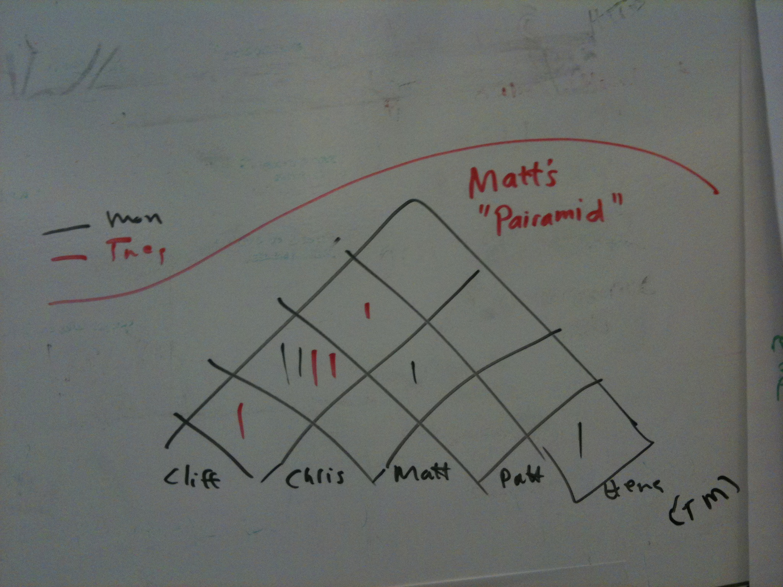
Pair Rotation Technique
Pair Stair / “Pairamid”
Encourages working with everybody

Slide 20
As a student, I want to calculate the area of a rectangle So that I can learn programming through geometry
Notes:
Job of a class, naming conventions
Extra features like diagonal
Commented out code, duplicate code

Slide 21
As a student, I want to calculate the perimeter of a rectangle So that I can learn programming through geometry
Notes:
Job of a class, naming conventions
Extra features like diagonal
Commented out code, duplicate code

Slide 22
As a student, I want to represent a square So that I can learn programming through geometry
Notes:
Job of a class, naming conventions
Extra features like diagonal
Commented out code, duplicate code

Slide 23
Recap
Notes:
Session objectives
Understand that Object Boot Camp is taught in the Socratic Method and focuses on hands-on labs.
Decide a class contract to follow throughout OBC
Understand basic OO terminology and coding standards
Be able to define the job of a class
Understand encapsulation
Unit testing

Slide 24
Test Driven Development

Slide 25
Test Driven Development
Why TDD?
All your code is testable by definition
Encourages better design by enforcing loose coupling
Tests as documentation
Clear examples of how to use APIs
Provably correct documentation
Confidence to allow refactoring
Can change the underlying design without changing behavior

Slide 26
Test Driven Development
Uncle Bob Martin’s Three Laws of TDD
You are not allowed to write any production code unless it is to make a failing unit test pass
You are not allowed to write any more of a unit test than is sufficient to fail; and compilation failures are failures
You are not allowed to write any more production code than is sufficient to pass the one failing unit test

Slide 27
TDD Demo

Slide 28
TDD Cycle
Red
The development of every new feature should start with a failing test
Green
Enough production code should be written to make the test pass.
Refactor
Improve the structure of the code to ease future changes and maintenance.

Slide 29
Basic structure of unit tests
Set up
Execute
Verify
Teardown

Slide 30
Organizing tests
One test class per class
One test case per scenario

Slide 31
Other key points
Test names should express intent
Keep test logic out of production code (e.g., no if(testing)… else … )
Ideally have only one assertion per test

Slide 32
Feathers’s rule of thumb
A test is not a unit test if:
It talks to the database
It communicates across the network
It touches the file system
It can't run at the same time as any of your other unit tests
You have to do special things to your environment (such as editing config files) to run it.

Slide 33
Object interactions
Notes:
What possible types of object interactions?

Slide 34
Delegations

Slide 35
Collaboration

Slide 36
Inheritance

Slide 37
3 != 3
Notes:
Units
Lost a satellite due to imperial and metric conversion

Slide 38
As a student, I want to compare lengths in feet and inches So that I can learn programming through geometry
1ft = 12in
Notes:
Unit as a string instead of Enum
Different unit classes for inch and feet
Conversion factor
If-else-elseif

Slide 39
As a student, I want to compare lengths in cms and inches So that I can learn programming through geometry
2 in = 5.08 cm
Notes:
Unit as a string instead of Enum
Different unit classes for inch and feet
Conversion factor
If-else-elseif

